Slide 1
Chapter 5 Probability Concept and Random Number Generation
Department of Computer Science and Engineering
Nepal Engineering College

Slide 2
Probability Concept
STOCHASTIC VARIABLES:
The variable which is random in nature is called stochastic variables.
Ex: Tossing of a coin, Rolling of dice
STOCHASTIC PROCESS
A stochastic process is a method that generates random output.
It is also defined as an order set of random variables.
The ordering of a set usually being with respect to time.
Stochastic activities are those activities where the output is random.

Slide 3
Probability Concept..
DISCRETE PROBABILITY FUNCTIONS
It is represented by a probability mass function(PMF).If a stochastic variable can take I different values xi for (i=1,2,3,4,5,…….I)and the probability of the value xi being taken as P(xi) i.e. xi → P(xi) ,the set of numbers P(xi) is said to be PMF and

Slide 4
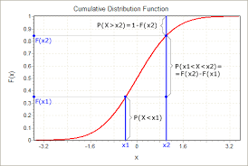
Probability Concept..
A cumulative distribution function is defined as a function that gives the probability of a random variable being less than or, equal to a given value. It can increased to a maximum of 1.

Slide 5
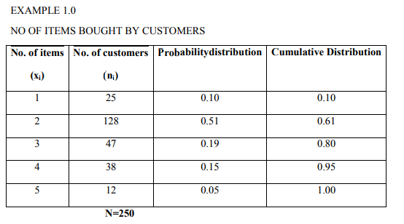

Slide 6
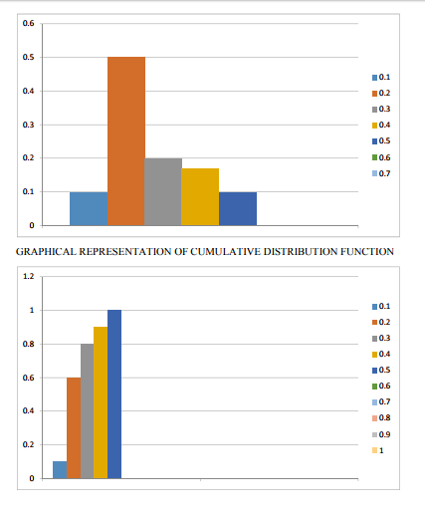
GRAPHICAL REPRESENTATION OF PROBABILITY MASS FUNCTION

Slide 7
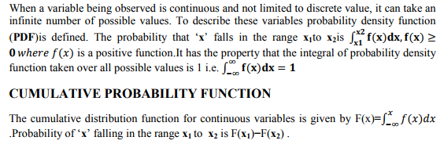
CONTINUOUS PROBABILITY FUNCTION

Slide 8
Random number and its Properties
A number generated for, or part of, a set exhibiting statistical randomness.
A random sequence is obtained from a stochastic process.
Random numbers are numbers that occur in a sequence such that two conditions are met:
(1) the values are uniformly distributed over a defined interval [0-1]-uniformity
(2) it is impossible to predict future values based on past or present ones-independence

Slide 9
Computer generation of random numbers
There are different methods
i) Congruence methods
Linear congruence generation (LCG)
Additive congruence generation
Multiplicative congruence generation
Mixed congruence generation
ii) Mid-square method
iii) Inverse transformation method
iv) Rejection method

Slide 10
Linear congruence generation
It produces the sequence of integer x1, x2 - - - - - between 0 and m-1 by following recursive relationship
xi+1= (axi+c) mod m ,i=0,1,2,.......... m-1
The initial value x₀ is called the seed.
a is called as multiplier,
c is called increment
m is modulus.
If c≠0 then the form is called mixed congruential generator.
If c=0 , then the form is called multiplicative congruential generator.
If a=1 , then the form is called additive congruential generator.

Slide 11
Linear congruence generation….
Examples:
Q1: Generate 4 digit random number by LCG with x₀=21, a=34, c=7.
Ans: Given generating 4-digit random number
i.e. m=10000 and
X₀=21, a=34, c=7.
X₁= (ax₀+c) mod m=(34*21+7) mod 10000= 721 R₁= X₁/m =721/10000=0.0721
X₂= (ax₁+c) mod m=(34*721+7) mod 10000=4521 R₂= X₂/m =4521/10000=0.4521
X₃= (ax₂+c) mod m=(34*4521+7) mod 10000= 3721 R₃= X₃/m= 3721/10000=0.3721
X₄= (ax₃+c) mod m=(34*3721+7) mod 10000=9311 R₄= X₄/m =9311/10000=0.9311
X₅= (ax₄+c) mod m=(34*9311+7) mod 10000=6581 R₅= X₅/m =6581/10000=0.6581

Slide 12
Q2: Generate 5 random numbers using additive congruential method with X₀=5, c=7, m=64.
Ans:
Here a=1, x₀=5, c=7, m=64
X₁= (ax₀+c) mod m= (1*5+7) mod 64= 12
R₁= X₁/m=12/64=0.1875
X₂= (ax₁+c) mod m=(1*12+7) mod 64=19
R₂= X₂/m= 19/64=0.2968
X₃= (ax₂+c) mod m= (1*19+7) mod 64= 26

Slide 13
R₃= X₃/m= 26/64= 0.4063
X₄= (ax₃+c) mod m= (1*26 +7) mod 64=33
R₄= X₄/m= 33/64= 0.5156
X₅= (ax₄+c) mod m= (1*33+7) mod 64= 40
R₅= X₅/m= 40/64= 0.625

Slide 14
Q3: Generate 5 random number using multiplicative congruential method with X₀=63, a=19, m=100.
Ans:
Given generating random numbers using multiplicative method i.e. c=0 and given X₀=63,a=19 , m=100
So X₁= (ax₀+c) mod m= (19*63+0) mod 100=97
R₁= X1/m=97/100=0.97
X₂= (ax₁+c) mod m=(19*63+0) mod 100=43
R₂= X₂/m= 43/100=0.43
X₃= (ax₂+c) mod m=(19*43+0) mod 100=17
R₃= X₃/m=17/100=0.17
X₄= (ax₃+c) mod m=(19*17+0) mod 100=23
R₄= X₄/m= 23/100=0.23
X₅= (ax₀+c) mod m==(19*23+0) mod 100=37
R₅= X₅/m=37/100=0.37

Slide 15
Q4: Use the mixed congruential method to generate a sequence of three 2-digit random number with X₀=37, a=7, c=29
Ans:
Given generating 2-digit random number so m=100 and given x₀=37, a=7, c=29
So X₁= (ax₀+c) mod m= (7*37+29) mod 100=88
R₁= X1/m=88/100=0.88
X₂= (ax₁+c) mod m=(7*88+29) mod 100=45
R₂= X₂/m= 45/100=0.45
X₃= (ax₂+c) mod m=(7*45+29) mod 100=44
R₃= X₃/m=44/100=0.44

Slide 16
Period of Random no. Generator
The max period(P) is: For m a power of 2, say m = 2^b, and c ≠ 0, the longest possible period is P = m = 2^b , which is achieved provided that c is relatively prime to m (that is, the greatest common factor of c and m is 1), and a = 1 + 4k, where k is an integer.
For m a power of 2, say m = 2^b, and c = 0, the longest possible period is P = m / 4 = 2^b-2 , which is achieved provided that the seed X0 is odd and the multiplier, a, is given by a = 3 + 8k or a = 5 + 8k, for some k = 0, 1,...
For m a prime number and c = 0, the longest possible period is P = m - 1, which is achieved provided that the multiplier, a, has the property that the smallest integer k such that ak - 1 is divisible by m is k = m - 1,

Slide 17
Exercise
Using the multiplicative congruential method, find the period of the generator for a = 13, m = 64, and X0 = 1, 2, 3, and 4. The solution is given in next slide. When the seed is 1 and 3, the sequence has period 16. However, a period of length eight is achieved when the seed is 2 and a period of length four occurs when the seed is 4.

Slide 18
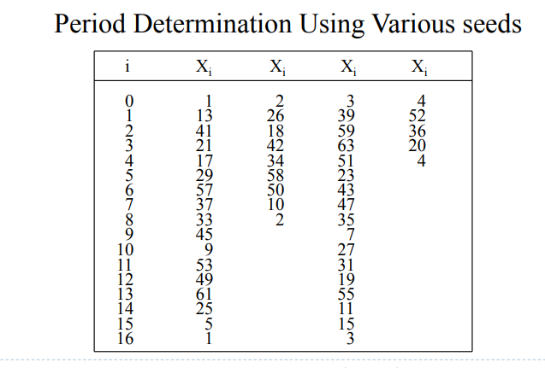

Slide 19
MID-SQUARE METHOD
This method was proposed by Von Neumann and metropolis.
The technique starts with an initial no. or seed.
This number is squared and the middle digit of the square becomes the random number after placement of the decimal.
Again the middle digits are squared to generate the second random number and so on.

Slide 20
Example:
X₀= 5497
(X₀)²= (5497)²
=30217009
X₁=2170
R₁= X₁/m= 2170/10⁴= 0.2170
(X₁)²= (2170)² = 04708900
X₂= 7089
R₂= X₂/m= 0.7089

Slide 21
Drawbacks:
Zeros are repeated in further numbers generated.
It starts degenerating for multiples of 10, 100, ……

Slide 22
TESTS FOR RANDOM NUMBERS
Properties of random number
Uniformity
Independence
UNIFORMITY:
Frequency Test:
It uses Kolmogorov-Smirnov or the Chi-square test to compare the distribution of the set of numbers generated to a uniform distribution.
INDEPENDENCE:
Auto-co-relation test:

Slide 23
It tests the co-relation between numbers and compares the sample co-relation to the expected co-relation that should be 0.
There are some more tests for independence-
Run test
Gap test
The testing for uniformity of the hypothesis are:
H₀: Ri~U[0,1] called null hypothesis.
The null hypothesis H0 reads that the random number distributed in between [0,1]
H₁:Ri notU[0,1]
Failure to reject the null hypothesis means that evidence of non-uniformity has not been detected by this test.
In test for independence the hypothesis are-
H0:Ri~independent
H₁:Ri independent rejected

Slide 24
KOLMOGOROV SMIRNOV
This test compares the continuous cdf F(x) of the uniform distribution with the empirical cdf S_{N}(x) of the sample of N observation.
By definition,
F(x)=x, 0<=x<=1
If the sample from the random number generator is-
R₁,R₂,R₃……R_{N}
S_{N}(n)=no. of R_{1,}R_{2,……} R_{N} which are <=x
This test is based on the statistical D=max | f(x)=S_{N}(x) |

Slide 25
KOLMOGOROV SMIRNOV
Step-1
Rank the data from smallest to largest. Let R_{i} denotes the smallest i^{th} observation-
R₍₁₎<=R₍₂₎<=……<=R_{(N)}
Step-2
Compute –
D⁺=max_{1<=i<N} {i/N-R_{(i)}}
D⁻=max_{1<=i<N} {R_{i}-(i-1)/N}

Slide 26
KOLMOGOROV SMIRNOV
Step-3
Compute D=max(D⁺,D⁻}
Step-4
Locate in table the critical value Dα for the specified significant table ‘ α’ & the given sample size ‘N’.
Step-5
If the sample statistic (D) > the critical value (D_{α}) the null hypothesis that the data are sample from a uniform distribution is rejected.
If D<= D_{α} conclude that no difference has been detected between the true distribution & the uniform distribution.

Slide 27
KOLMOGOROV SMIRNOV
For each test a table of significance ‘ α’ is tested. This table is the probability of rejecting the null hypothesis , when the null hypothesis is true.
The decision marker sets the value of ‘ α’ for any tests frequently α=0.01 or 0.05.

Slide 28
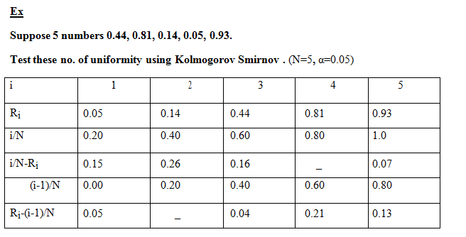

Slide 29
Step-1
D⁺=0.26
Step-2
D⁻=0.21
Step-3
D=max(0.26,0.21)=0.26
Step-4
α=0.05 , N=5
D α=0.565
Step-5
As D<D α, the sequence of random no. is uniformly distributed & the null hypothesis is not rejected.

Slide 30
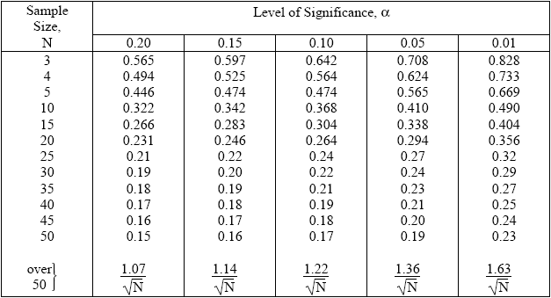
Kolmogorov Smirnov Table

Slide 31


Chi-Square Test
The test uses the sample statistics
Where, Oi = The observed number in the ith class
Ei = Expected number in the ith class
n = Number of classes
For uniform distribution Ei is given by,
Where, N = Number of Observation
n = classes
It is generally done when N≥0.

Slide 32
Chi-Square Test
Q: Test the following number for uniformity by Chi-square test. 0.15, 0.22, 0.11, 0.25, 0.09, 0.01, 0.28, 0.07, 0.13, 0.03 with 5% level of significance.
A: Here, N = 10 n = 10
Let us set the hypothesis
H0:Ri~U[0,1]
H1:Ri not ~U[0,1]

Slide 33
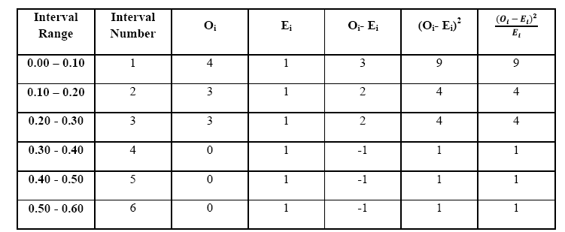
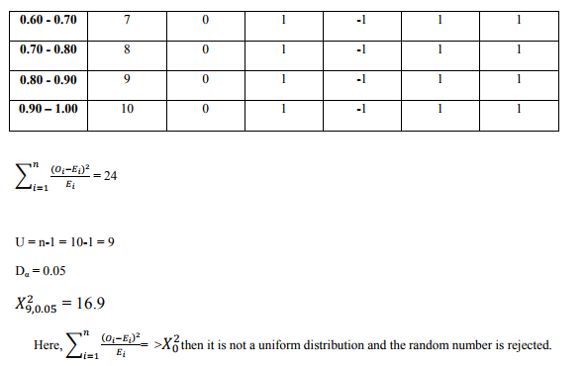

Slide 34
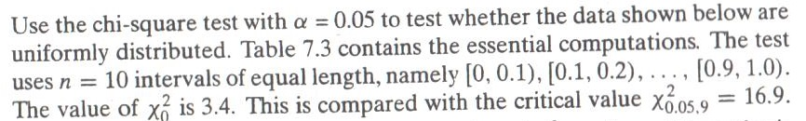
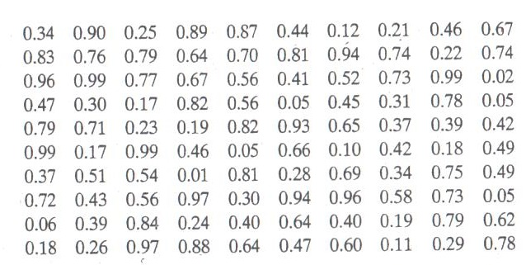

Slide 35
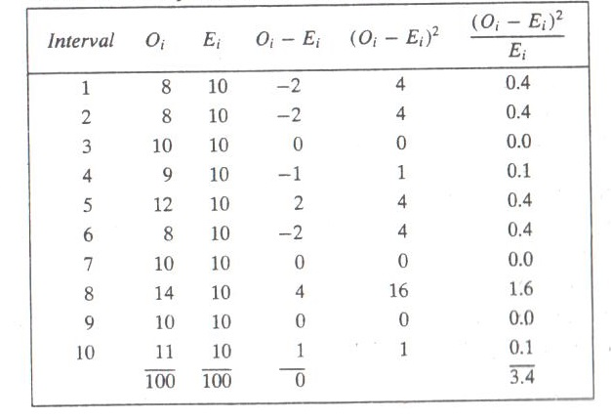

Slide 36
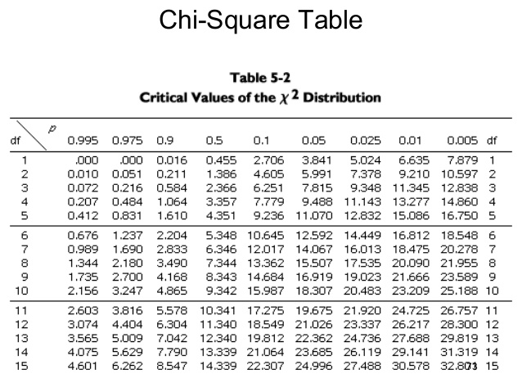

Slide 37
Run Test (Test for independence)
This test examines the arrangement of numbers in a sequence to test the hypothesis of independence.
Run:
Run is defined as a succession of similar events proceeded & followed by a different event.
H T T H H T TT H T
1 2 3 4 5 6
Total run=6
Length of run:
Length of the run is the no. of the event occur in the event.
HTTHHTTTHT
1 2 2 3 1 1

Slide 38
Run Test cont..
UP RUN:
An up run is a sequence of number each of which is succeeded by a larger number- 0.07 0.12 0.53 0.85 0.92
Down Run:
A down run is a sequence of numbers each of which is succeeded by a smaller no.

Slide 39
Run Test
If ‘a’ is the total no. of runs in a truly random sequence the mean & variance of ‘a’ is given by-
Mean
µ _{a}=(2N-1)/3
Variance
σ_{a}²=(16N-29)/90
=>j16l 29/90

Slide 40
Run Test cont…
Test Statistic
Z₀=(total no. of runs-mean)/standard deviation
=>(a-µ _{a})/σ_{a}
where Z₀ is normally distributed variable
Failure to reject hypothesis of independence occurs when -Z_{α}<=Z₀<=Z_{α/2} where α is the label of significance.

Slide 41
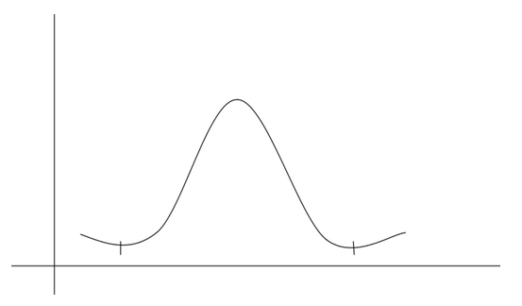

Slide 42
Run Test cont..
Steps
Find the sequence of runs up & runs down.
Find total no. of runs denoted by ‘a’.
Find mean & standard deviation.
µa=(2N-1)/3
Variance=σa 2 =(16N-29)/90
Standard deviation σa
Compute the test statistic Z₀=(a-µ _{a})/σ_{a}
Compare it with the theoretical value.
If - Z_{α/2}<Z₀<= Z_{α/2}, then null hypothesis of independence cannot be rejected on the basis of test and the sequence of random no. is independent. Hence it passes the runs test.

Slide 43
Run Test
Perform runs test on the following sequence of random numbers :
0.08, 0.09, 0.43, 0.29, 0.42, 0.53, 0.68, 0.10, 0.76, 0.98
Solution:
In test for independence, the hypothesis are-
H0:Ri~independent
H₁:Ri independent rejected
Let us now calculate the Runs up(H) and Run Down (T)
HH T HHH T HH
1 2 3 4 5
No. of runs a=5,
N=10
Mean,
µa=(2N-1)/3=((2*10)-1)/3=19/3=6.33
Variance=σa 2 =(16N-29)/90=((16*10-29)/90=1.455
Standard deviation σa=√1.455
Test statistic Z0=(no. of runs-mean)/standard deviation =(5-6.33)/√1.455 =-1.099

Slide 44
Run Test
Critical value Suppose α=0.05 α/2=0.025
-Zα/2=-1.96, Zα/2=1.96
Therefore, -1.96<=Z₀<=1.96, so we cannot reject the null hypothesis of independence on the basis of this test & this sequence of numbers passes the runs test.

Slide 45

Tests for Auto-correlation
The tests for auto-correlation are concerned with the dependence between numbers in a sequence.
Let us consider the following sequence
0.12 0.01 0.23 0.28 0.89 0.31 0.64 0.28 0.83 0.93
0.99 0.15 0.33 0.35 0.91 0.41 0.60 0.27 0.75 0.88
0.68 0.49 0.05 0.43 0.95 0.58 0.19 0.36 0.69 0.87
The test computes the auto-correlation between every m numbers (m is also known as the lag) starting with the ith number.
Thus the autocorrelation between the following numbers would be of interest.

Slide 46


The value M is the largest integer such that where N is the total number of values in the sequence.
Test statistic is calculated as

Slide 47
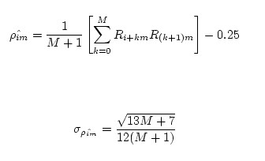
which is distributed normally with a mean of zero and a variance of one.
The actual formula for and the standard deviation is

Slide 48

After computing , do not reject the null hypothesis of independence if
where is the level of significance.

Slide 49
From given table, test whether the 3rd, 8th , 13th and so on, numbers are auto correlated. Given 5% level of significance.
Solution:
In test for independence, the hypothesis are-
H0:Ri~independent
H₁:Ri independent rejected
Here,
First term i=3,
Lag m=5,
M=4 (large integer such that i+(1+M)m<=N)

Slide 50
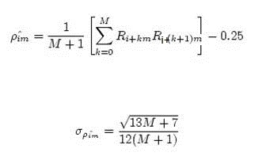
Let us calculate

Slide 51
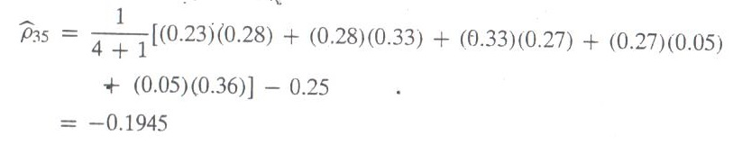
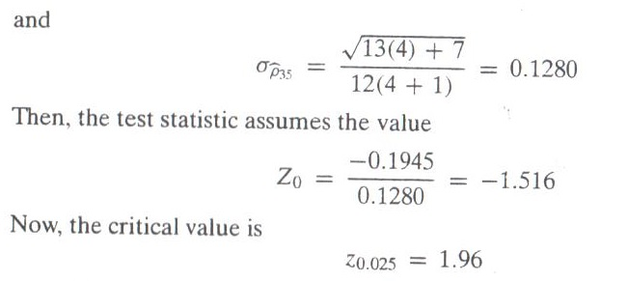

Slide 52
Now,
ie -1.96<-1.516<1.96
Therefore, the null hypothesis of independence cannot be rejected based on this test.

Slide 53
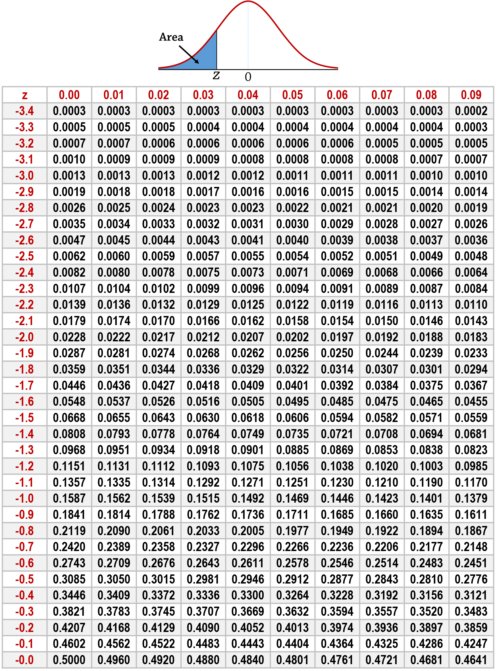

Slide 54
Poker Test
The Poker Test is the test for independence based on the frequency with which certain digits are repeated with in a series of numbers.
This test not only tests for the randomness of the sequence of numbers, but also the digits comprising of each of the numbers.
Problem:
A sequence of 10,000 random numbers, each of four digits has been generated. The analysis of the numbers reveals that in 5120 numbers all four digits are different, 4230 contain exactly one pair of like digits, 560 contain two pairs, 75 have three digits of a kind and 15 contain all like digits. Use Poker test to determine whether these numbers are independent. (Critical value of chi-square test for α=0.05 and N=4 is 9.49).

Slide 55
Solution:
Let us first set the following hypothesis
H0: Ri are independence
H1: Ri are not independence
In four digit number, there are five different possibilities
All individual digits can be different
There can be one pair of like digit
There can be two pair of like digits
There can be three digits of a kind
There can be four digits of a kind
The probabilities associated with each of the possibilities is given by
P (four different digits) = 4C4 * (10/10) * (9/10) * (8/10) * (7/10) = 0.504 [nCr=n!/(r!*(n-r)! It calculates the number of ways to choose r items from a set of n items where the order of selection doesn't matter.]
P (one pair) = 4C2 * (10/10) * (1/10) * (9/10) * (8/10) = 0.432
P (two pair) = (4C2/2)*(10/10) * (1/10) * (9/10) * (1/10) = 0.027
P (three digits of a kind) = 4C3 * (10/10) * (1/10) * (1/10) * (9/10) = 0.036
P (four digits of a kind) = 4C4 * (10/10) * (1/10) * (1/10) * (1/10) = 0.001

Slide 56
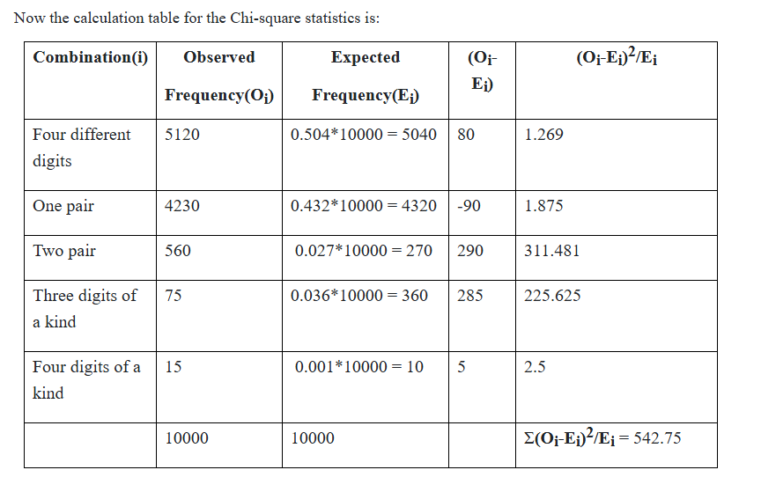

Slide 57

=542.75
and from table ꭔ²_{0.05,4} = 9.49
Here the calculated value of chi-square is 542.75 which is greater than the given tabulated value of chi- square so we reject the null hypothesis of independence.

Slide 58
Poker for three digits number
In a three digit number, there are only three possibilities.
The individual digits can be all different. Case 1.
The individual digits can all be the same. Case 2.
There can be one pair of like digits. Case 3.
P(case 1) = P(second differ from the first) * P(third differ from the first and second) = 0.9 * 0.8 = 0.72
P(case 2) = P(second the same as the first) * P(third same as the first) = 0.1 * 0.1 = 0.01
P(case 3) = 1 - 0.72 - 0.01 = 0.27

Slide 59
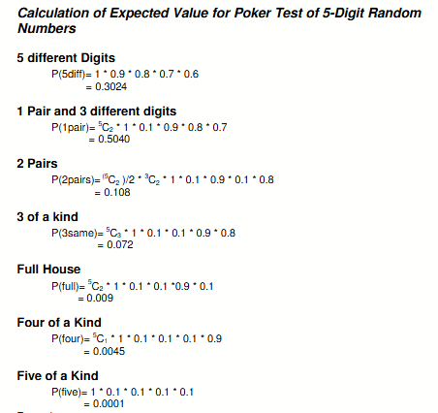

Slide 60



Gap Test
The gap test is used to determine the significance of the interval between recurrence of the same digit. A gap of length x occurs between the recurrence of some digit
The probability of a particular gap length can be determined by a Bernoulli trail.
If we are only concerned with digits between 0 and 9, then
The theoretical frequency distribution for randomly ordered digits is given by

Slide 61

Gap Test Algorithm
Step 1. Specify the cdf for the theoretical frequency distribution given by Equation
Step 2. Arrange the observed sample of gaps in a cumulative distribution with these same classes.
Step 3. Find D, the maximum deviation between F(x) and S N (x)as in Equation
D=max |F (x) - S (x)|
Step 4. Determine the critical value, D α, from Table( K-S critical value) for the specified value of α and the sample size N.
Step 5. If the calculated value of D is greater than the tabulated value of D tabulated value of D α , the null hypothesis of independence the null hypothesis of independence is rejected

Slide 62
4, 1, 3, 5, 1, 7, 2, 8, 2, 0, 7, 9, 1, 3, 5, 2, 7, 9, 4, 1, 6, 3 ,3, 9, 6, 3, 4, 8, 2, 3, 1, 9, 4, 4, 6, 8, 4, 1, 3, 8, 9, 5, 5, 7, 3, 9, 5, 9, 8, 5, 3, 2, 2, 3, 7, 4, 7, 0, 3, 6, 3, 5, 9, 9, 5, 5, 5, 0, 4, 6, 8, 0, 4, 7, 0, 3, 3, 0, 9, 5, 7, 9, 5, 1, 6, 6, 3, 8 ,8, 8, 9, 2, 9, 1, 8, 5, 4, 4, 5, 0, 2, 3, 9, 7, 1, 2, 0, 3, 6, 3
( 110 numbers)
Based on the frequency with which gaps occur, analyze the 110 digits above to test whether they are independent. Use level of significance 5%.
The number of gaps is given by the number of digits minus 10
ie 110-10=100.
Solution:
Let us first set following null and alternative to null hypothesis
H0: Given numbers are independent
H1: Given numbers are not independent

Slide 63
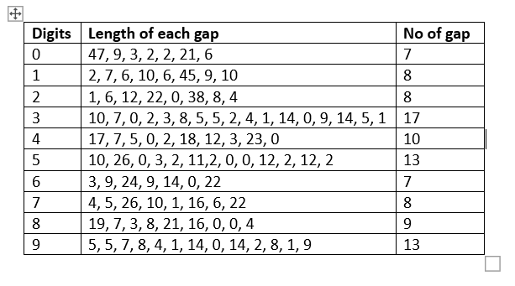
The length and the number of gaps associated with the various digits are as follows:

Slide 64
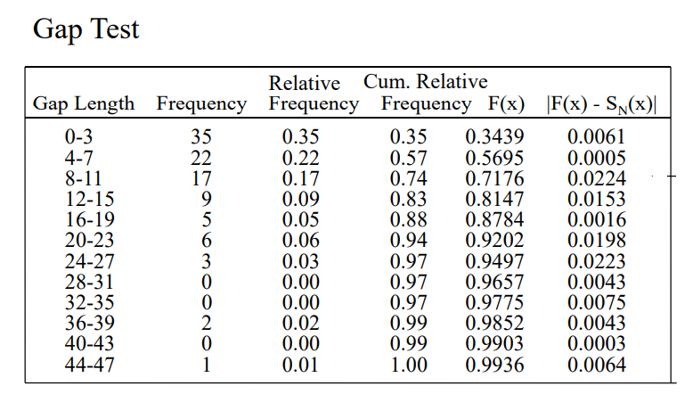
F(x)=1-0.9^(3+1)
=1-0.9^(7+1)
…=1-0.9^(47+1)

Slide 65
The critical value of D is given by
D0.05,100 = 1.36 /sqrt( 100) = 0.136 [Refer KS Table]
Since D = max |F( x ) - S(x)| = 0.0224 is less than D0.05, do not reject the null hypothesis of independence on the basis of this test.

Slide 66
Assignment
What is random number and how is it different from pseudo random number? What are the two desired properties of random numbers?
Use linear congruential method to generate three two digits random with X0=27, a=8, =47 and m=100.
Do we encounter the problem if X0=O in question no. 2?
Generate random number using mid square method using seed value 9867.
Write any two tests available for testing the uniformity of given numbers? Write algorithm with suitable example.
Explain the independenceand uniformity property of random number. For the following sample of random numbers, perform test for independence using K-S test. (D0.05,10 = 0.41)
0.35, 0.77, 0.12, 0.33, 0.88, 0.45, 0.19, 0.25, 0.91, 0.54
Write any two tests available for testing the independence of given numbers? Write algorithm with suitable example.
A sequence of 1000 three-digit numbers has been generated and an analysis indicates that 680 have three different digits, 289 contain exactly one pair of like digits, and 31 contain three like digits. Based on the poker test, are these numbers independent? Given α = 0.05.
Based on runs up and runs down, determine whether the following sequence of 40 numbers is such that the hypothesis of independence can be rejected where α = 0.05.
0.41 0.68 0.89 0.94 0.74 0.91 0.55 0.62 0.36 0.27 0.19 0.72 0.75 0.08 0.54 0.02 0.01 0.36 0.16 0.28 0.18 0.01 0.95 0.69 0.18 0.47 0.23 0.32 0.82 0.53 0.31 0.42 0.73 0.04 0.83 0.45 0.13 0.57

Slide 67
Assignment
A sequence of 1000 four digit numbers has been generated and analysis indicates the following combinations with frequencies:
Combination (i) Observed Frequency{O i }
Four different digits 570
One pair 380
Two pairs 34
Three like digits 15
Four like digits 1
Based on poker test check whether the numbers are independent. Use c=0.10 and N=4 is 7.78
Write an algorithm for Gap test for testing the independence of random numbers.
Solve all the questions from Chapter 5 from old question collection.
PU Stamped table link: https://drive.google.com/file/d/1_7r6JMCiOuo3ozd6gm4g3_si5xrOHdBK/view?usp=drive_link

